Slide 1
INTRODUCTION TO ARTIFICIAL INTELLIGENCE
By: Aminat Akinyemi-Ayoola (MSc. Hull)
Academic Director & AI Facilitator,
Robotics and Artificial Intelligence Nigeria.

Slide 2
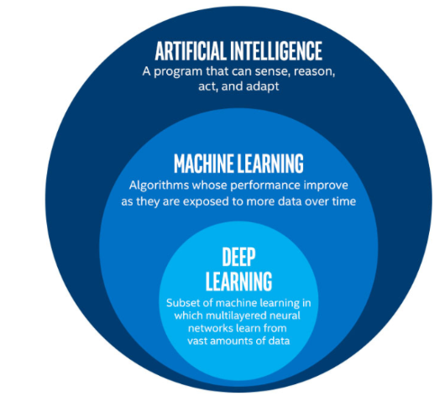

Slide 3
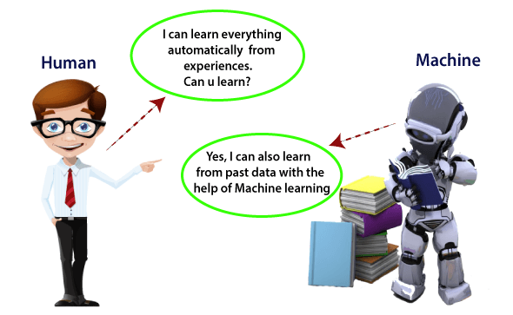

Slide 4
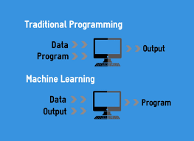
Machine learning
Machine learning is an aspect of Artificial Intelligence that allows computers to predict an outcome without explicitly programmed.

Slide 5
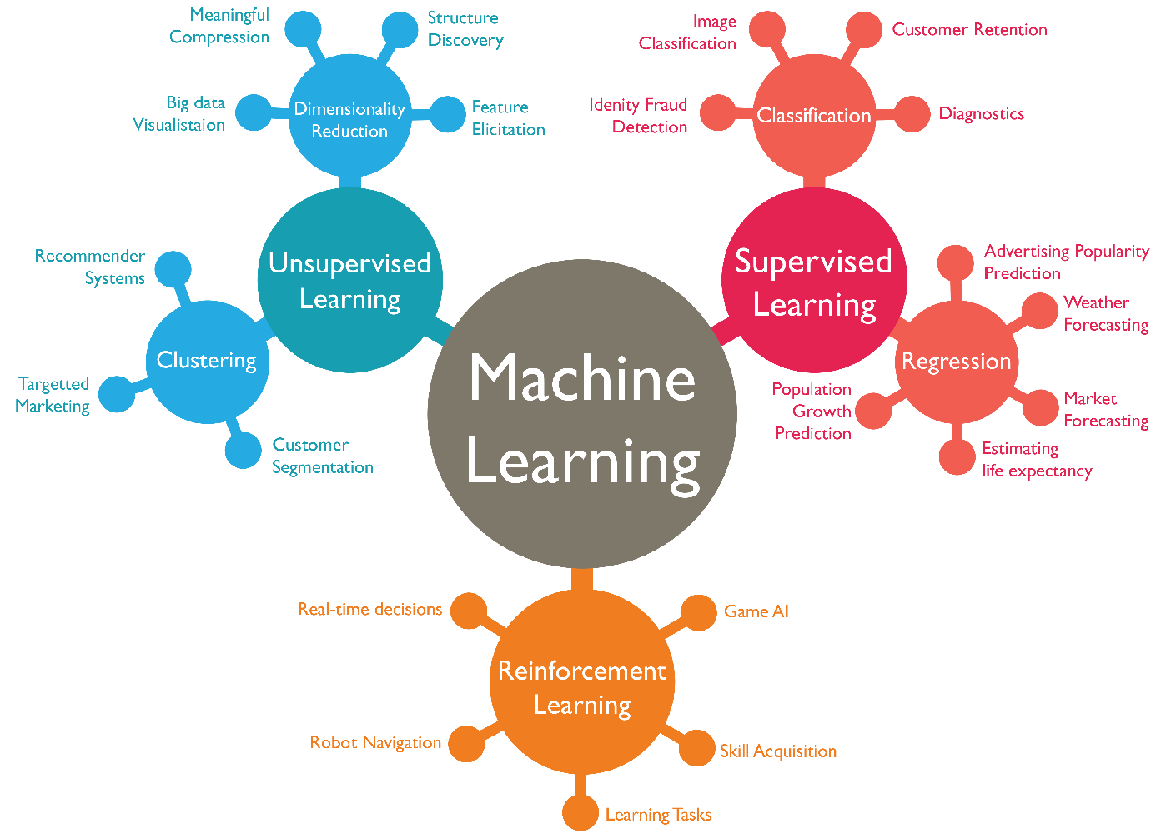
Types of Machine Learning

Slide 6
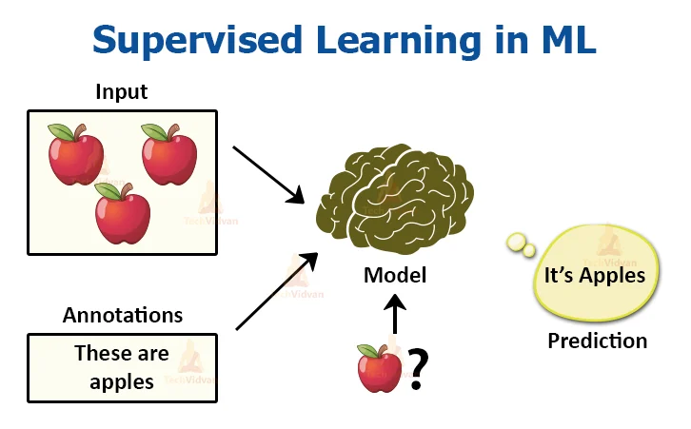
Supervised machine learning learns from a labeled dataset. In regression, the outcome to predict is a continuous value. In Classification, the outcome to predict is a category (categorical / discrete data)

Slide 7
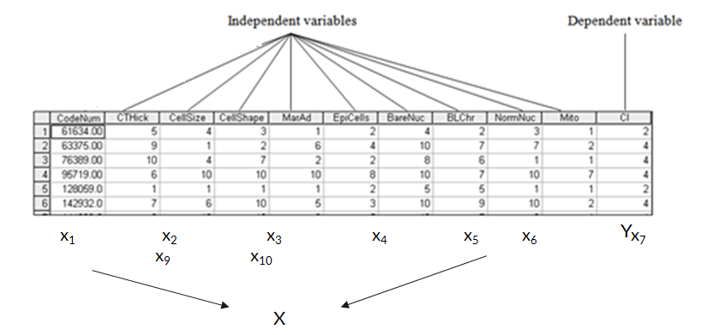
LABELLED DATA

Slide 8
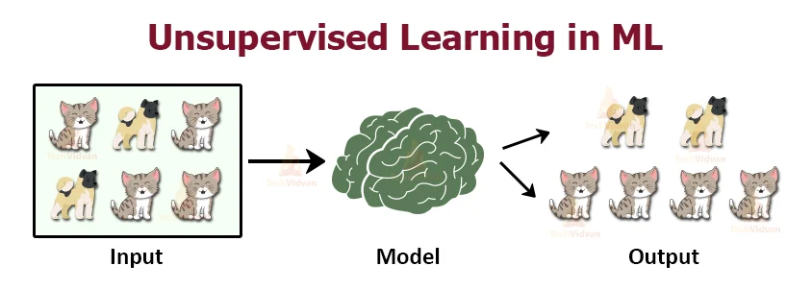
Unsupervised machine learning learns from an unlabeled dataset. In clustering, data points are grouped / clustered based on similarities.

Slide 9
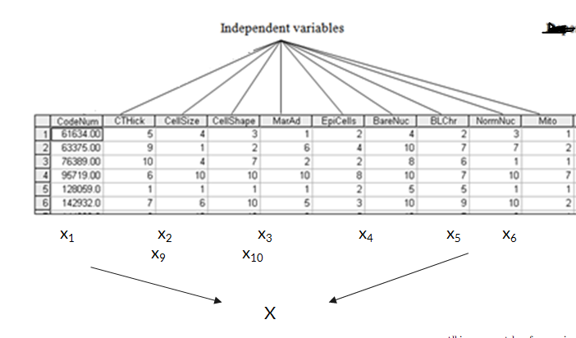
UNLABELLED DATA

Slide 10






Machine Learning Tools

Slide 11
Machine Learning Applications
Medical diagnosis
Recommendation systems
Fraud detection
Speech recognition
Object recognition
Spam detection

Slide 12
Deep Learning
Computer Vision
Natural Language Processing

Slide 13
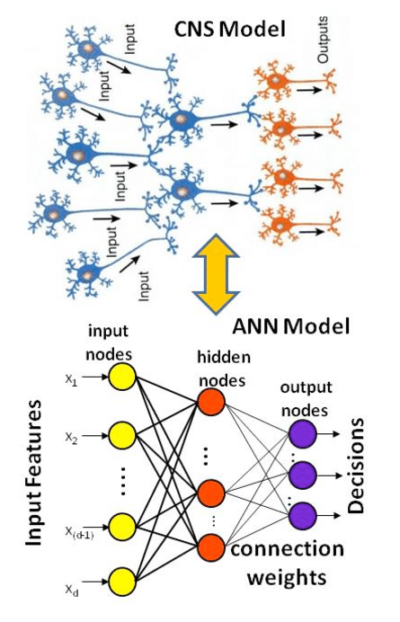
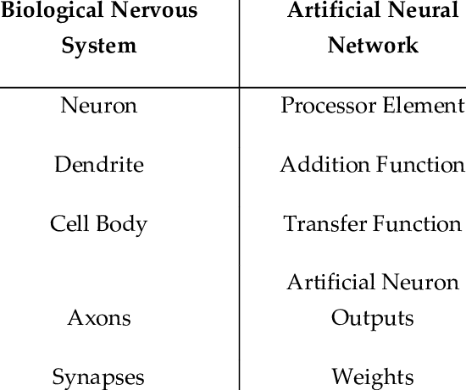
Human Brain vs. Neural Networks

Slide 14
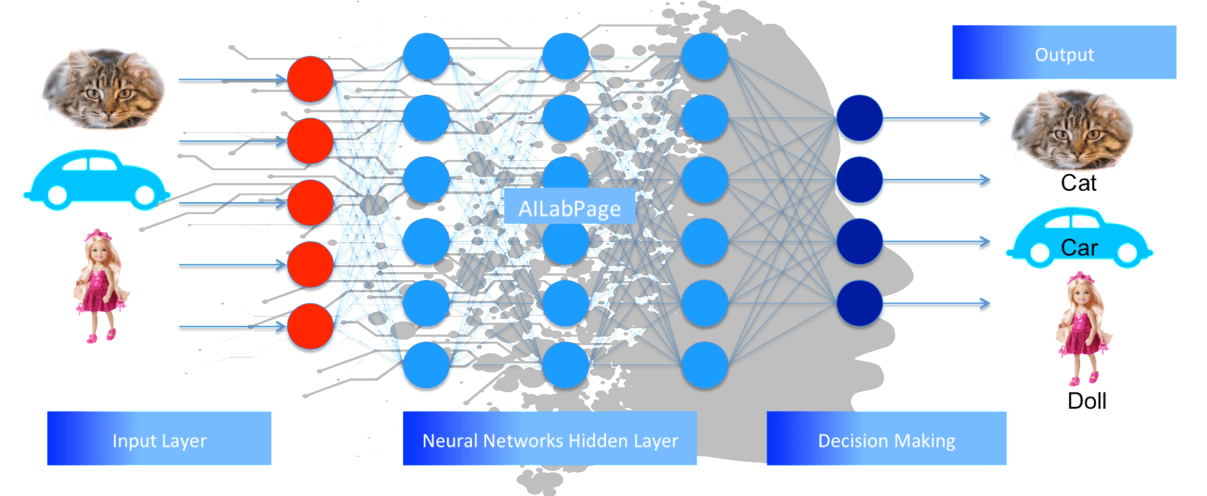
Neural Networks

Slide 15
Types of Neural Network
Vanilla Neural Networks
Convolutional Neural Network
Recurrent Neural Network
Long Short Term Memory
Generative Adversarial Network

Slide 16
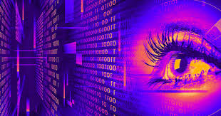
Computer Vision
Computer vision is an aspect of Artificial intelligence that enables a computer to process and recognise visuals (images, videos) just like human beings can do.

Slide 17
Applications of Computer Vision
Image classification
Face detection and recognition
Object detection
Image segmentation
Virtual reality / Augmented reality
Human Pose Estimation
And many more

Slide 18
Natural Language Processing
NLPis an aspect of Artificial intelligence that enables a computer to process and understand natural languages just like human beings can do.

Slide 19
Applications of NLP
Speech recognition
Voice recognition
Text processing
Sentiment Analysis
Chat bot
Voice Interaction

